Slide 1
R.A.W.
Remote Armwrestling
SDP Team 12
Tyler Costa, Steve Lucey, Zach Matthews, Steve McGrath
Notes:
Steve L.

Slide 2
Problem Statement
Many have trouble with motivation to exercise
Friendly physical competition may provide incentive
Why not connect distant friends with a physical competition of strength?
Remote arm wrestling is physical interaction with friend
More personal than call alone
Friends will challenge each other to exercise and get stronger
https://www.onnit.com/academy/finding-workout-motivation-how-to-stop-saying-no-to-goals/
Notes:
Steve L.
If friends plan to meet at bar with RAW at end of week, more likely to work out that week.
https://www.google.com/url?sa=i&rct=j&q=&esrc=s&source=images&cd=&cad=rja&uact=8&ved=0ahUKEwi3xfTA5PbWAhWLPCYKHbgsCiMQjRwIBw&url=https%3A%2F%2Fwww.pinterest.com%2Fpin%2F164381455119064701%2F&psig=AOvVaw0vlvB1OXIHQGuxyQWCiMzB&ust=1508299652782709

Slide 3
The Product
The idea is to create two robotic arms that are connected by a high speed internet connection.
Each arm would be able to replicate the force and strength of the opposite user
It will make it so two people could armwrestle each other from long distances
The results of the matches would get submitted into a database which would rank users based on their performances
Information accessible through application
Notes:
Steve L.

Slide 4
System Requirements
A sturdy robotic arm
Average forearm and hand length
Torque sensing/replication
Maximum torque: 90 Nm
High speed connection for communicating between arms
Operates with non-perceivable delay
An application for creating an account and monitoring results
Safety function to seize up the arm
Notes:
Zach

Slide 5
Design Alternatives
Haptic Armwrestling:
This product will not meet all our specifications
It does not have:
A phone application with user accounts
Set of statistics to personalize user
Strength tiers for more competitive games
https://newatlas.com/go/3562/
Notes:
Zach

Slide 6
Each Member's Contribution
Tyler Costa: Motor System, Power Supply, and Arm Motion Replication
Steve Lucey: Server/Client/Database for Application, Arduino Programming
Zach Matthews (Team Leader): Raspberry Pi Programing, High Speed Connection, GUI for Application
Steve McGrath: System Padding, Force Replication, Feedback Control System, and Emergency Stop
Notes:
Tyler

Slide 7
Block Diagram
Robotic Arm
Application
Power Supply
Motor System
System Padding
GUI
Server/Client
Arm Motion Replication
Database
Pressure Sensing
Force Replication
Feedback Loop
Networking
Maroon - Zach
Green - Tyler
Yellow - Steve L.
Blue - Steve M.
Safety
Microcontroller
Raspberry Pi
Emergency Stop
Arduino
High Speed Connection
Notes:
Tyler

Slide 8
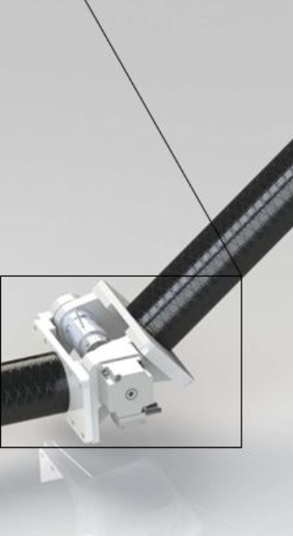
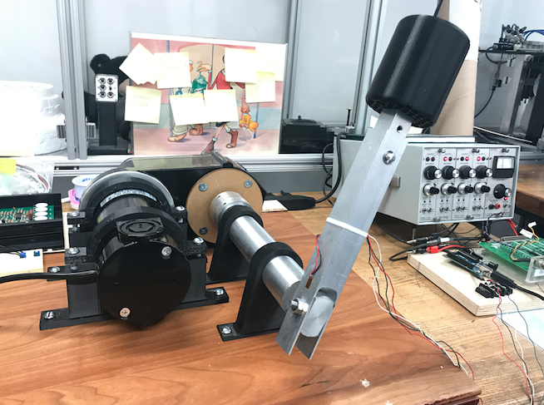
Subsystem: Robotic Arm
Continuous DC motor to control shoulder rotation
Servo Motor to control elbow flex
90 degree rotating hand to avoid wrist torsion (45 degrees in either direction)
Variable elbow angle to prevent excessive torque on shoulder
Motor strength exceeds the support of the largest torque generated by arm wrestling
Slowly return to the original position
http://sreal.eecs.ucf.edu/people/phd/rpillatproject7.php
http://carnot.mech.columbia.edu/~sd/2017/11/index.html
Notes:
Tyler
Servo Motors can easily connect to raspberry pi

Slide 9
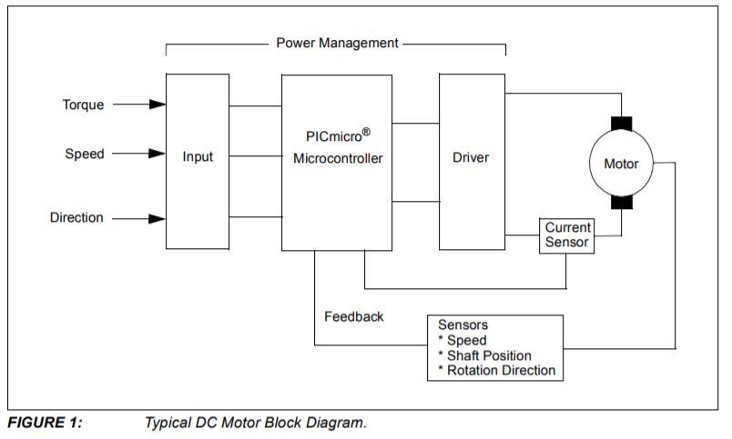
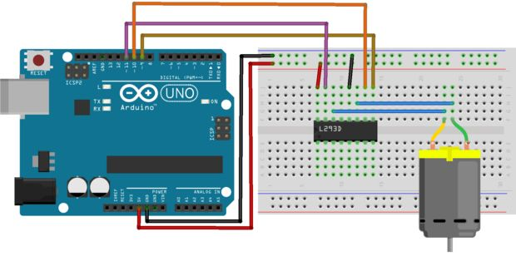
Subsystem: Pressure Sensing
Servo motor does not require feedback
Initial input of speed, torque, position, etc. is fed into the microcontroller
DC motor is driven by L293D chip to control speed and direction
Feedback circuit will be programmed in MATLAB and interface with an Arduino to regulate parameters and calculate torque
Data will be stored and transferred via high speed connection to other arm using Raspberry Pi 3
http://www.instructables.com/id/Control-DC-Motor-Using-L293D/
http://ww1.microchip.com/downloads/en/AppNotes/00894a.pdf
Notes:
Steve M.
http://www.instructables.com/id/Control-DC-Motor-Using-L293D/
http://ww1.microchip.com/downloads/en/AppNotes/00894a.pdf
https://www.eetimes.com/document.asp?doc_id=1274118

Slide 10
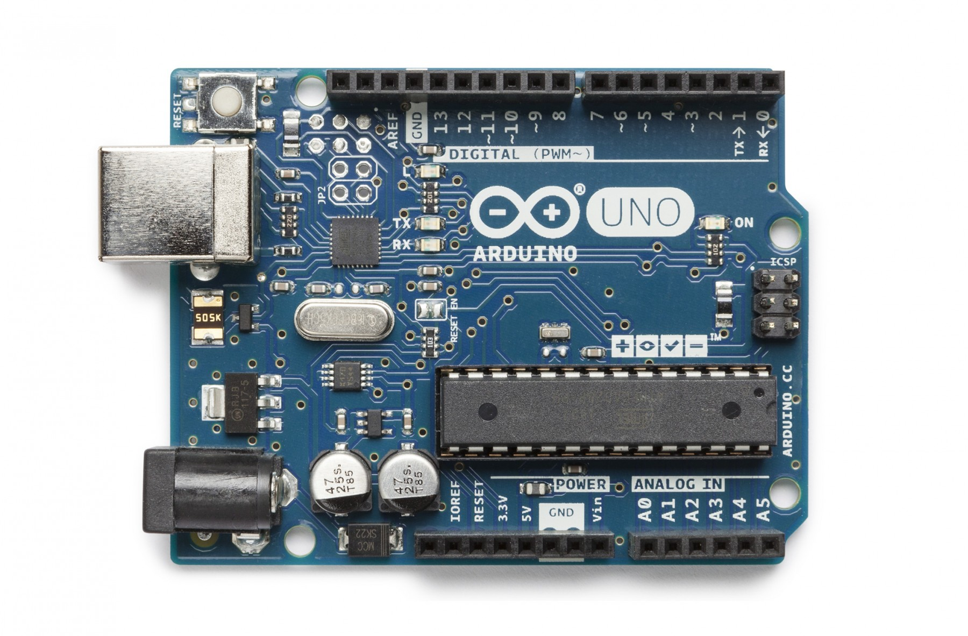
Subsystem: Microcontroller
Arduino Uno
Used to program DC motor/Servo motor
Gather torque replication data
Used in addition to Raspberry Pi to not take away CPU power
https://store-cdn.arduino.cc/usa/catalog/product/cache/1/image/1800x/ea1ef423b933d797cfca49bc5855eef6/A/0/A000066_front_2.jpg
Notes:
Zach

Slide 11
Subsystem: Safety
Emergency Stop:
Rubber contact on arm with force from spring of ~180N
Hold back spring with induced magnetic force
Activates when:
Safety button near off-hand is pressed
Power cuts out
Arm is moving too fast
Strength Classes:
Only allowed to arm wrestle someone in your strength range
Notes:
Steve L.
Rubber stopper forced onto upper arm portion with large spring

Slide 12
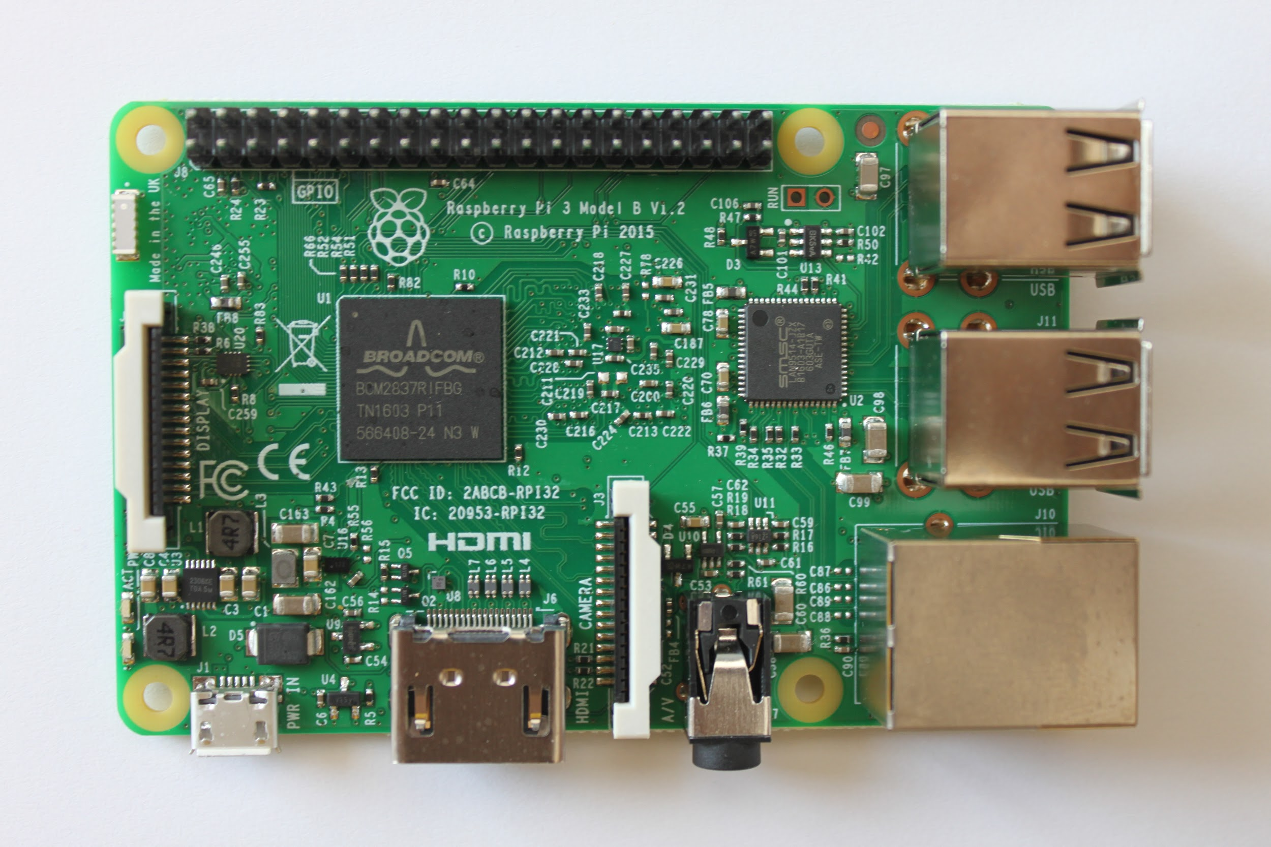
Subsystem: Networking
Raspberry Pi 3
Used for high speed connection
Controls data transfer between arms
Retrieves data from Arduino
Sends torque data to opposite Raspberry Pi
https://shop.pimoroni.com/products/raspberry-pi-3
Notes:
Zach

Slide 13
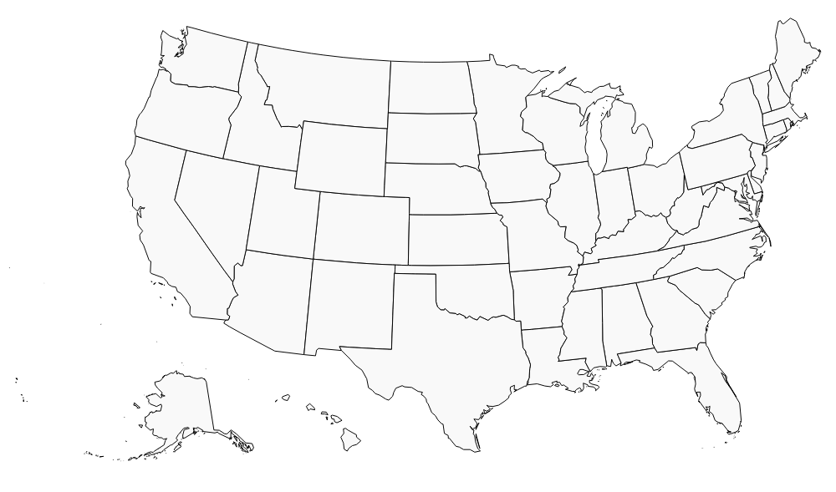
Subsystem: Application
iPhone application for personal user
Connects to database to pull user information and stats
Displays tier of arm wrestling user and helps set up matches
Helps user find a location with a RAW arm wrestling simulator
http://simplemaps.com/static/demos/resources/svg-library/svgs/us.svg
Notes:
Steve L.
http://simplemaps.com/static/demos/resources/svg-library/svgs/us.svg

Slide 14
Additional Features
Time Permitting:
Virtual Headset
Players can wear headset when playing
What they will see is an avatar of their opponent
Practice Matches
Save history of users matches
Allow other users to practice against your previous matches
Elbow sensing
Weight sensor to determine if users elbow is in correct position
Will be able to know if user lifts elbow to cheat
Notes:
Steve M.

Slide 15
Budget
2 Arm Replicants: $80.00
2 Emergency Stops: $20.00
2 DC Motors: $200.00
2 Servo/Stepper motors: $40.00
2 Pressure Sensing Pads: $5.00
2 Accelerometers: $15.00
2 Raspberry Pi 3: $70.00
2 Arduino: $40.00
2 Power Supply: $20.00
Total: $480.00
Notes:
Steve M.

Slide 16
Risks
Hardware:
Motors need to represent with 1% of actual torque of user
Arm replicates movement of user
No noticeable gap in signal so arm will move properly
Software:
Raspberry Pi’s CPU does not get overloaded to maintain connection
Arduino correctly programs motor to closely represent user
Server runs with fault tolerance
Client data backed up in database
Notes:
Zach

Slide 17
MDR Deliverables
1 Arm with Basic Movement Capabilities:
Starts in armwrestling position
Can move corresponding to given human input
Resist motion +/- 5 degrees of starting position
Not networked
Application:
Will have basic GUI with simulated functionality
Local database
Notes:
Tyler

Slide 18
FDR and Demo Day Presentation
FDR:
Two fully functional arms
Accurately replicate user's motion and force to opposite arm
Fully functional corresponding application
All client/server functions fully operational
Emergency Safety Stop implemented
Demo Day:
Allow guest to use arms
Limit range of arms so no person could get hurt
Brackets hinder further motion one specific angle is reached and match ends
Notes:
Steve M.
Emergency Safety Function
Hard Stop at angle

Slide 19
Questions?

